Slide 1

Holt Band Boosters
Welcome and Introduction Meeting

Slide 2
Agenda
Welcome and Introductions
Who Are the Boosters?
Board of Directors-Supporting Roles
Key Dates
Comments/Discussion
Next Meeting- See You Tuesday September 13, 2022
Adjournment

Slide 3
Who are the Boosters?
Alone we can do so little, together we can do so much

Slide 4
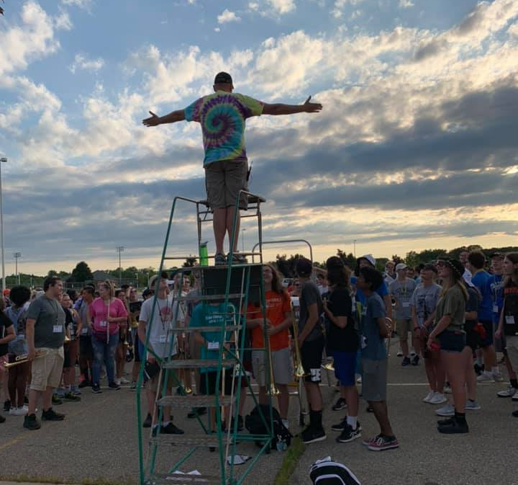
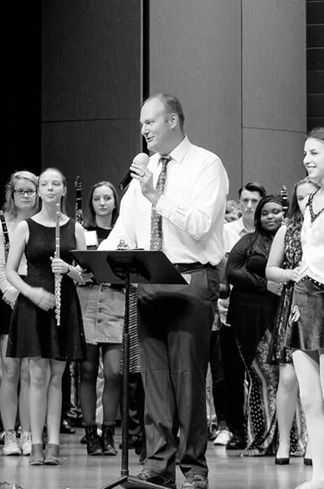
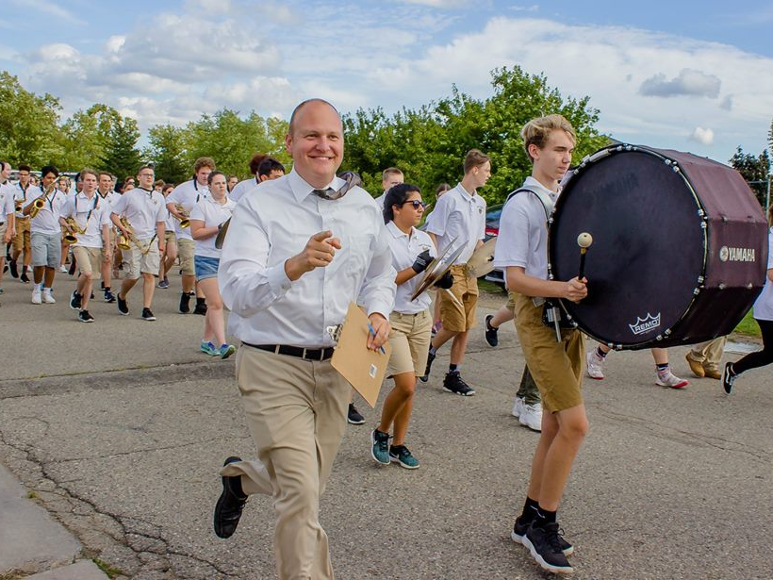
Support the Bands and Director
HHS Band Boosters, Inc.

Slide 5

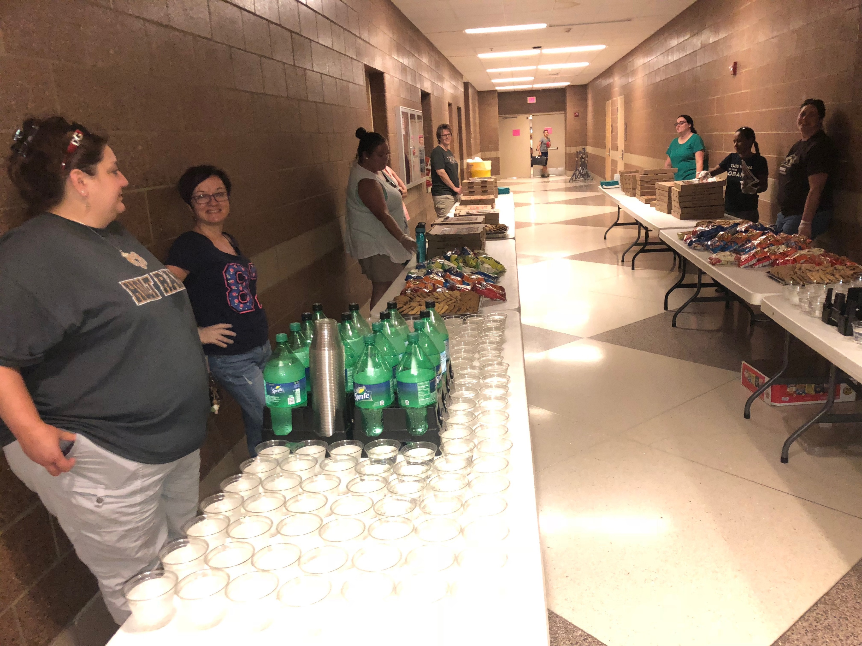
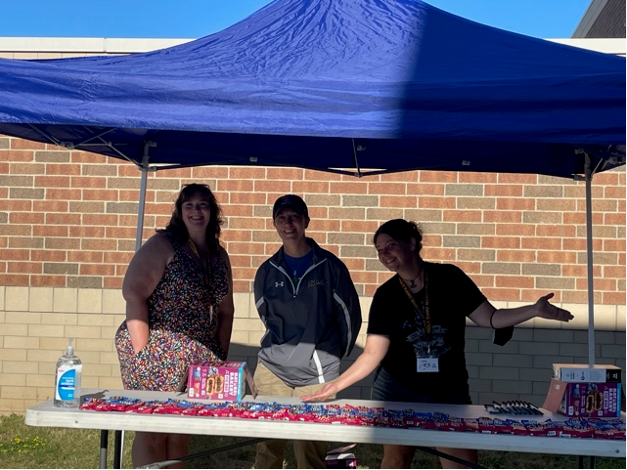
Band Camp

Slide 6
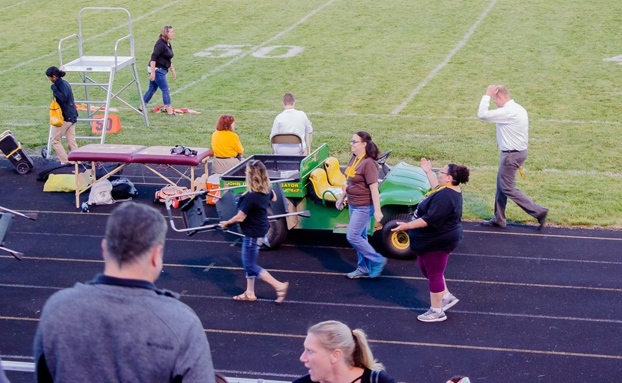
Football Games

Slide 7

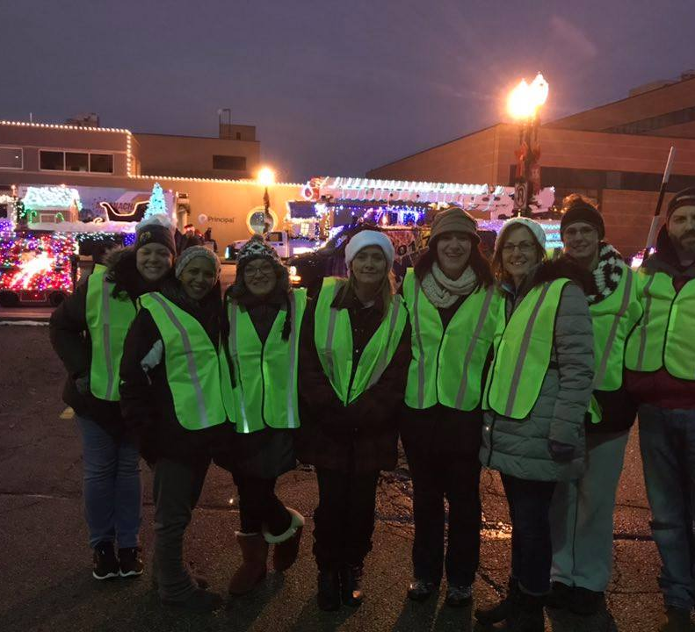
Parades

Slide 8
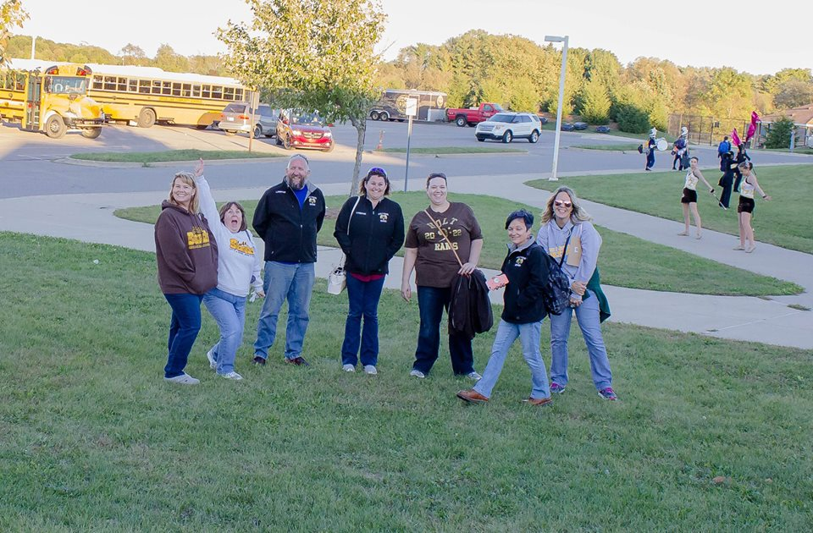
Chaperone
Events and Trips

Slide 9

Fundraisers
Donations, Spirit Wear

Slide 10
Who Are The Boosters?
All of You!

Slide 11

Board of Director Support

Slide 12
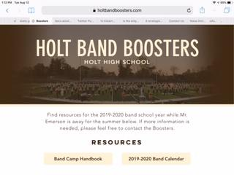
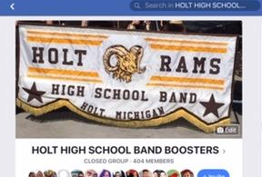
Vice President:
Matt Lincoln
Face Book, Media

Slide 13
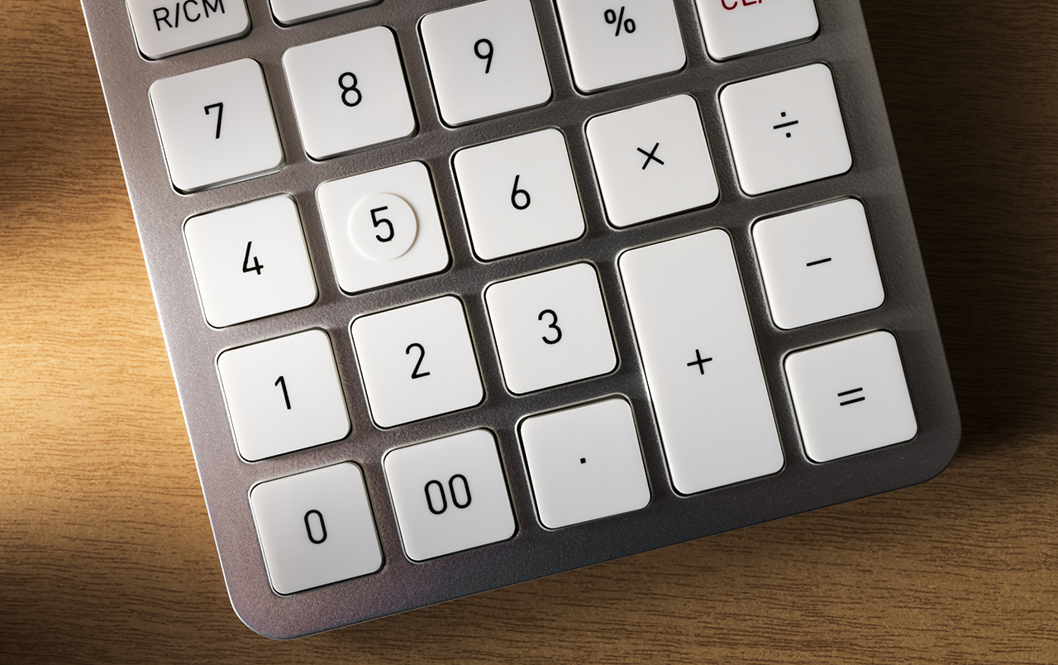
Treasurer:
Lori Underhill
Assistant Treasurer:
Jen Elliott

Slide 14
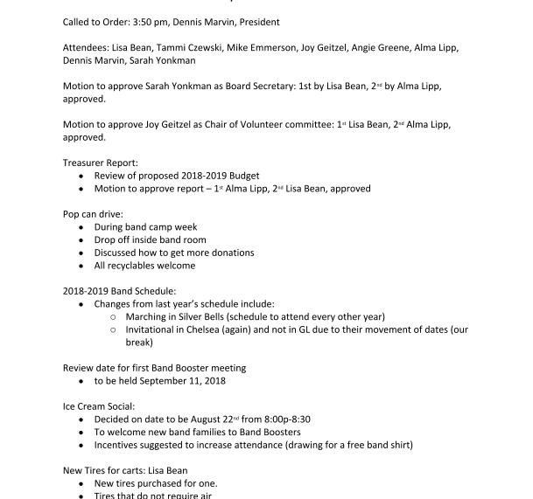
Secretary:
MariaRosa Palmer

Slide 15
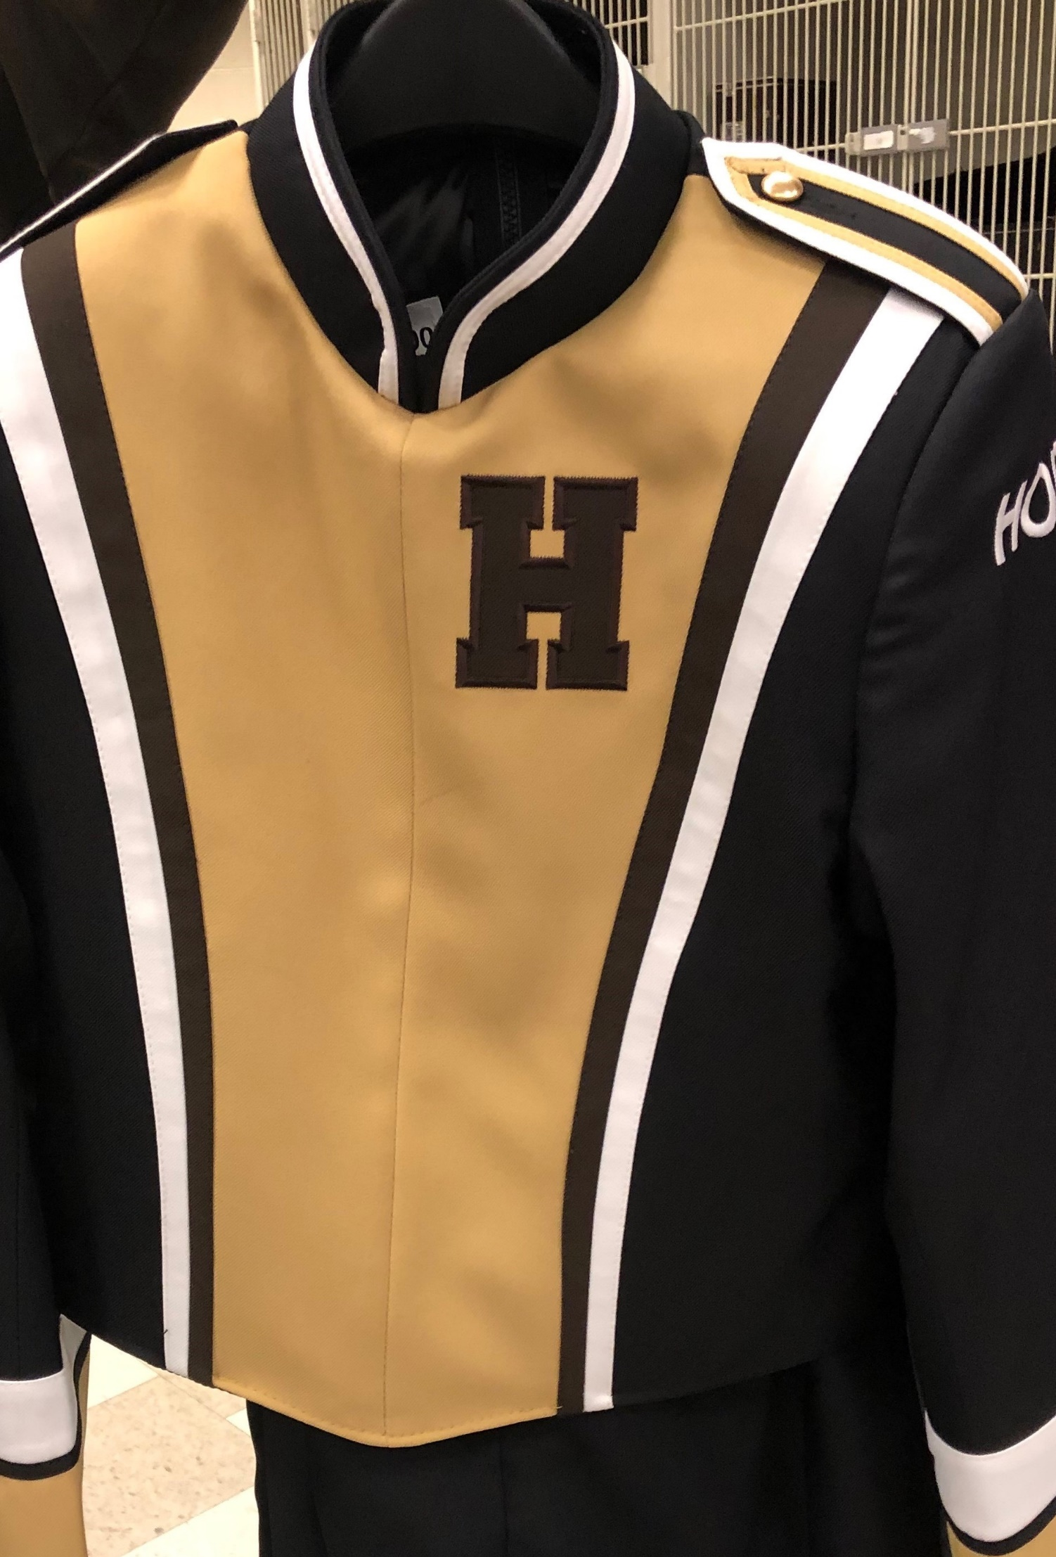
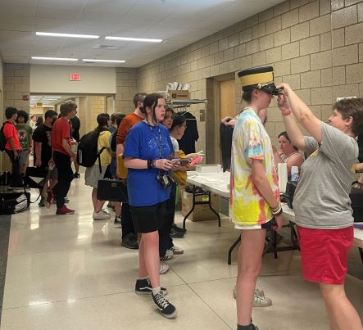
Uniform Chair:
TBD

Slide 16
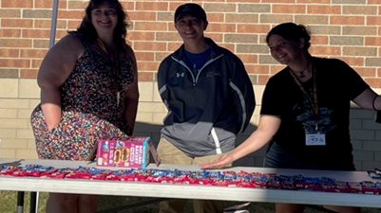
Volunteer Chair:
Dawn Carmody- to be confirmed

Slide 17
Fundraising Chair:
Ann-Marie Lindley

Slide 18
Key Dates Going Forward
Event | Event Date | Comments
Football Game* | Sept 1 | Sign Up Genius
Band Boosters Meeting | Sept 13 | Band Room 7 p.m.
Football Game(Homecoming) | Sept 16 | Sign Up Genius
Grand Ledge Marching Show | October 5 | Sign Up Genius
Football Game (Light Show) | Oct 7 | Sign Up Genius
Football Game( Light show) | Oct 14 | Sign Up Genius
Football Game (Sr Night) | Oct 21 | Sign Up Genius
*See Mr Emerson’s Calendar for details on HHS Boosters Web Site
https://www.holtbandboosters.com/

Slide 19
https://youtu.be/8RNo8tyWGp8

