Slide 1
Holt High School Band Boosters
General Meeting
March14, 2023

Slide 2
Agenda
Welcome
Board of Director Updates
Boosters Financial Updates-Treasurers Report
Key Dates Going Forward
Volunteer Opportunities
Fundraising Activities
Band Festival
Band-Aid
Band Director’s Report
Open Discussion
Next Meeting-April 11, 2023, 7 p.m.
Adjournment

Slide 3
Board of Director Reports
Matt Lincoln Vice President
MariaRosa Palmer Secretary
Lori Underhill Treasurer
Jenn Elliott Asst Treasurer
Patty Dokum Uniform Committee
Dawn Carmody Volunteer Committee
Ann-Marie Lindley Fundraising Committee

Slide 4
Treasurer’s Reports
February,2023
Beginning Balance (All Accounts) – February 1,2023 $28859.67
Ending Balance (All Accounts) – February 28,2023 $26, 137.93

Slide 5
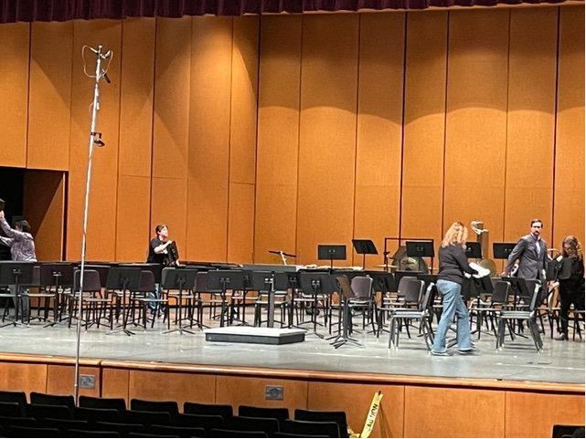
Volunteer Opportunities/Upcoming EventsatesGoing Forward
Event | Event Date | Comments
Band Aid Concerts- Spaghetti Dinner- 50/50 Raffle | March 21, 2023 | Auditorium and Commons
Wind Ensemble Tri District Concert | April 19, 2023 | Location TBD 6pm
Jazz Band at Thornapple Jazz Fest | April 27 or 28, 2023 | TBD- at Hastings
Spring Concert Awards Night | May 18, 2023 | Auditorium and Commons

Slide 6
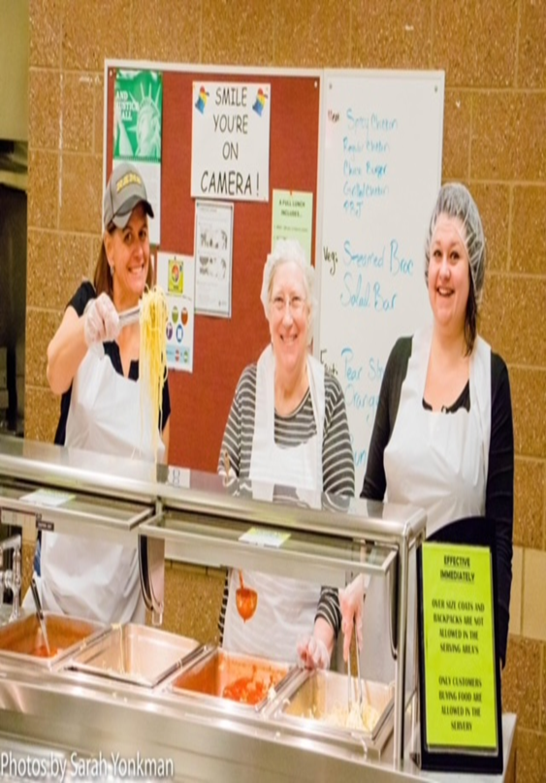
Fundraising Activities
Band Aid- 50/50 Raffle and Spaghetti Dinner March 21, 2023
Band Festival – concessions report out

Slide 7
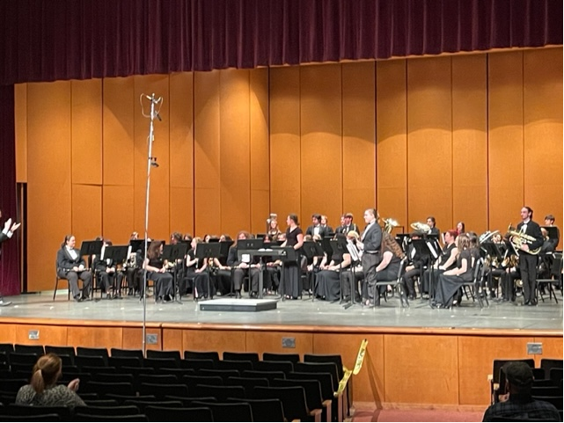
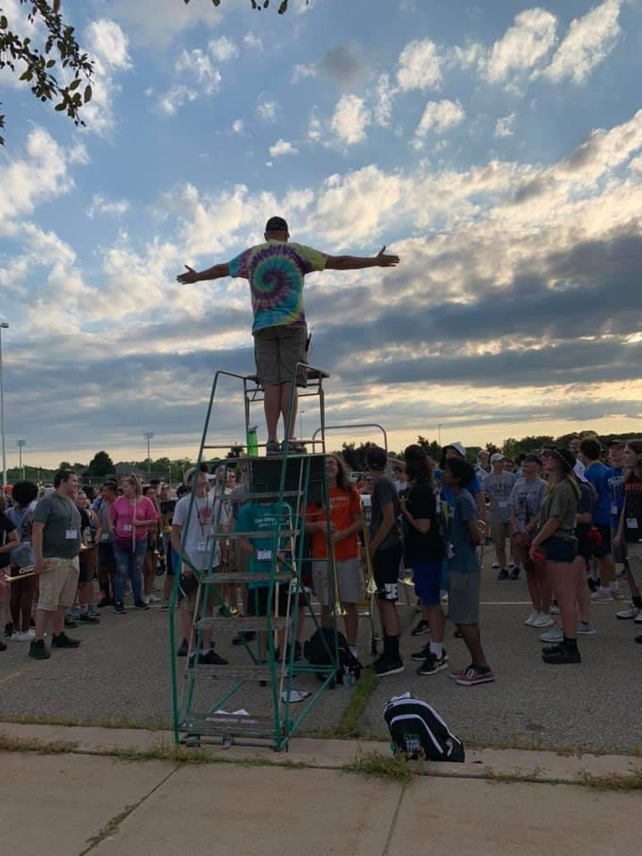
Band Director Report
.

Slide 8
Don’t Forget Our Web Site
www.holtbandboosters.com

Slide 9
…..And Facebook Page….

Slide 10
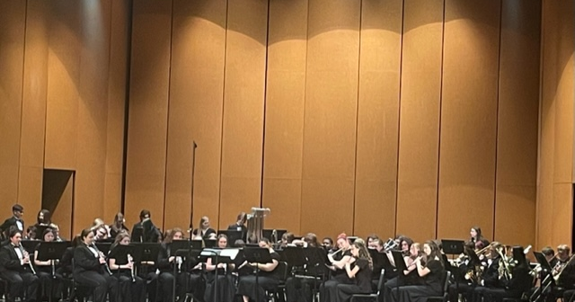
Next Meeting April 11, 2023 Thank You For Joining!

