Slide 1



Holt Band Boosters
General Meeting
November 14, 2023

Slide 2
Agenda
Welcome and Introductions
Review Agenda
Updates from the Executive Board and Band Director
Key Dates
Comments/Discussion
Next Meeting- Tuesday 10/3/2023
Adjournment

Slide 3
Vice President’s Report
Update on trailer logo
Silver Bells Parade- transport all set-
Shelving update
Notes:
Lights on the trailer?

Slide 4


Treasurer’s Report
Notes:
Jason will also present the letter for the 2023 annual financial records review.

Slide 5
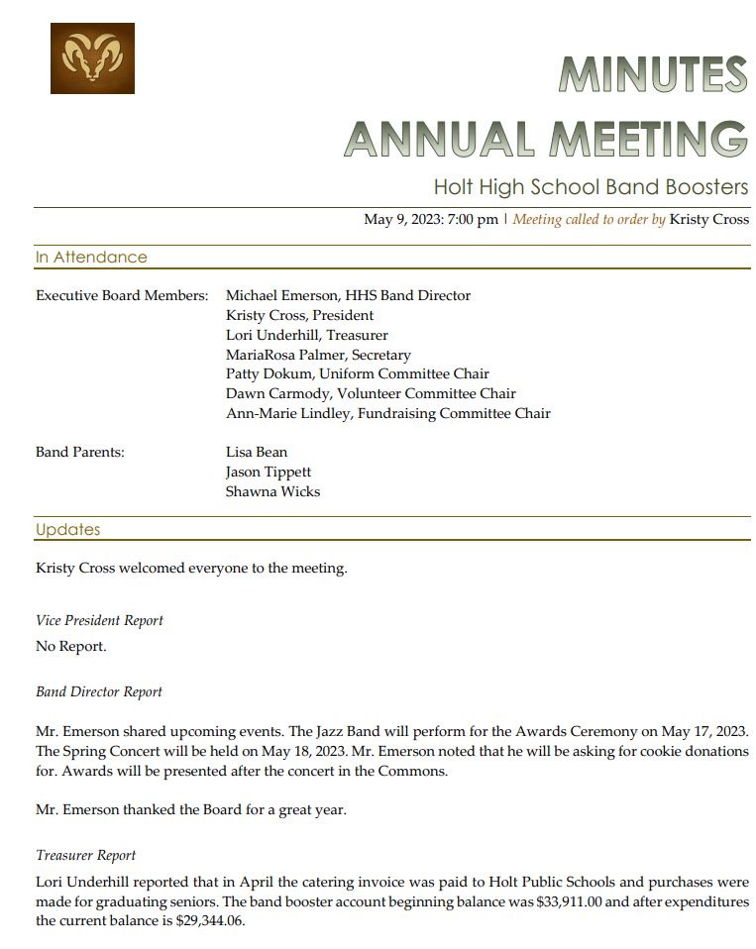
Secretary’s Report

Slide 6
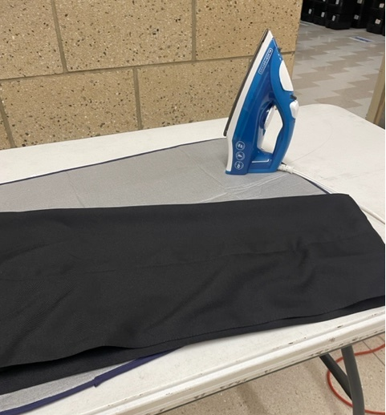
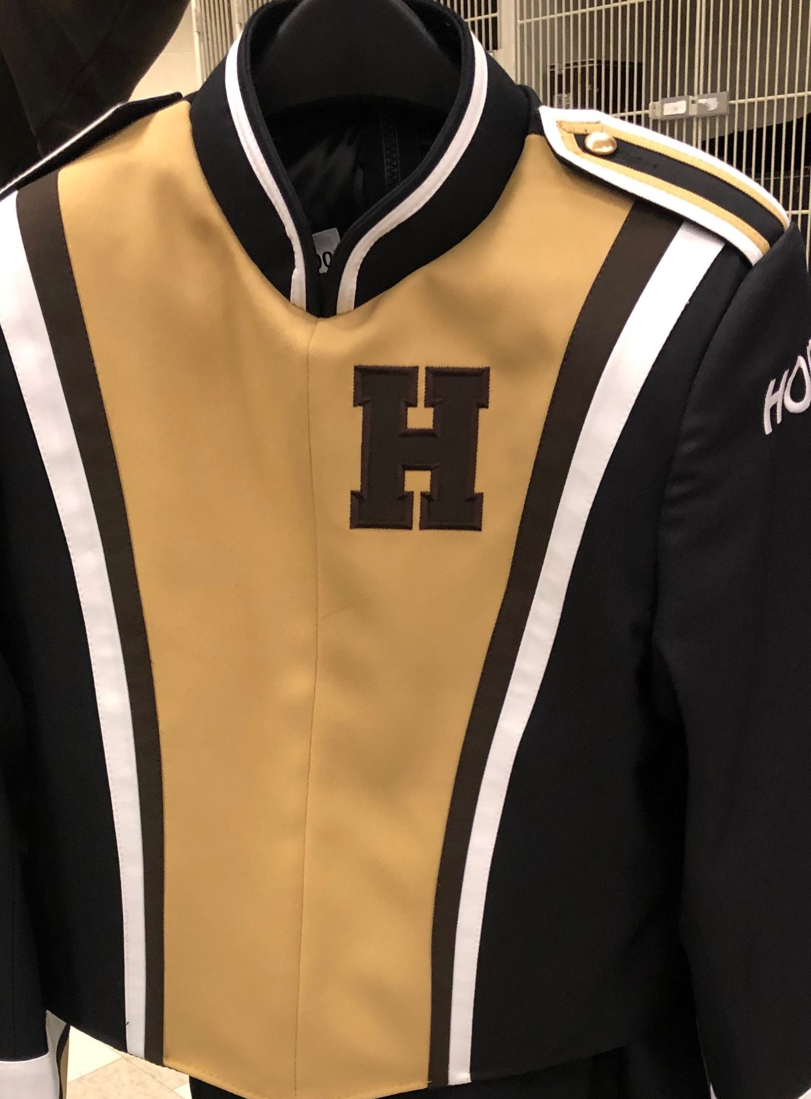
Uniform Chair Report
Notes:
For the new Wind Ensemble uniforms Patty will review the vest orders and clarify the additional expense there.

Slide 7
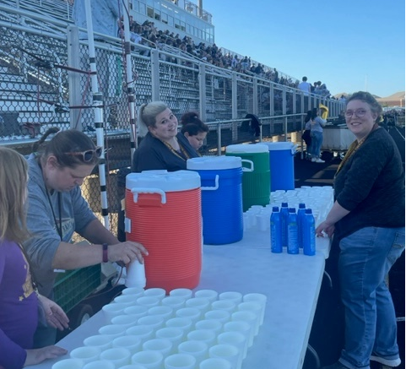
Volunteer Chair’s Report

Slide 8


Fundraising Chair Report
Notes:
Wreaths here 4-6pm Thursday 11/16
We did meet to begin planning spaghetti dinner and festival.
We still plan to have the school prep the meal and do a 50/50 raffle.
Plan to advertise earlier and just have on 50/50 raffle
For Festival- not planning concessions- does the Band Director need other support?

Slide 9
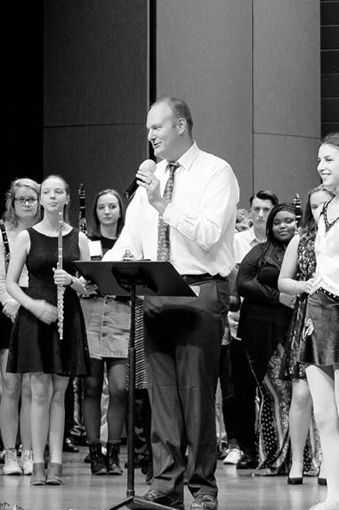
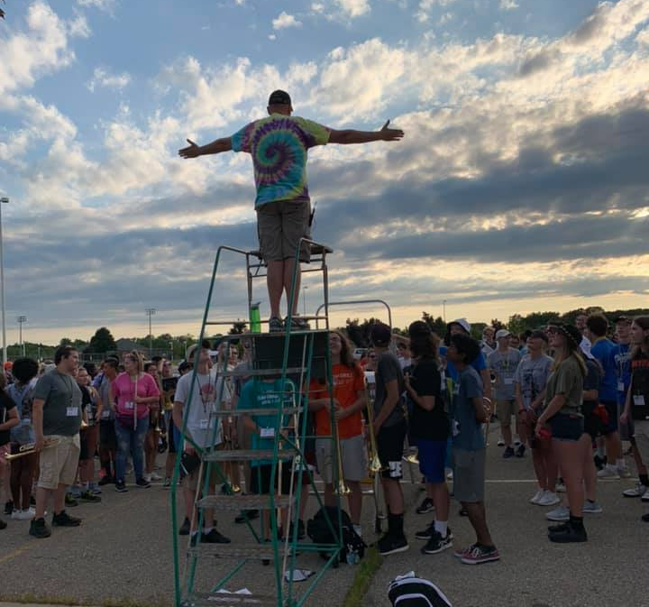
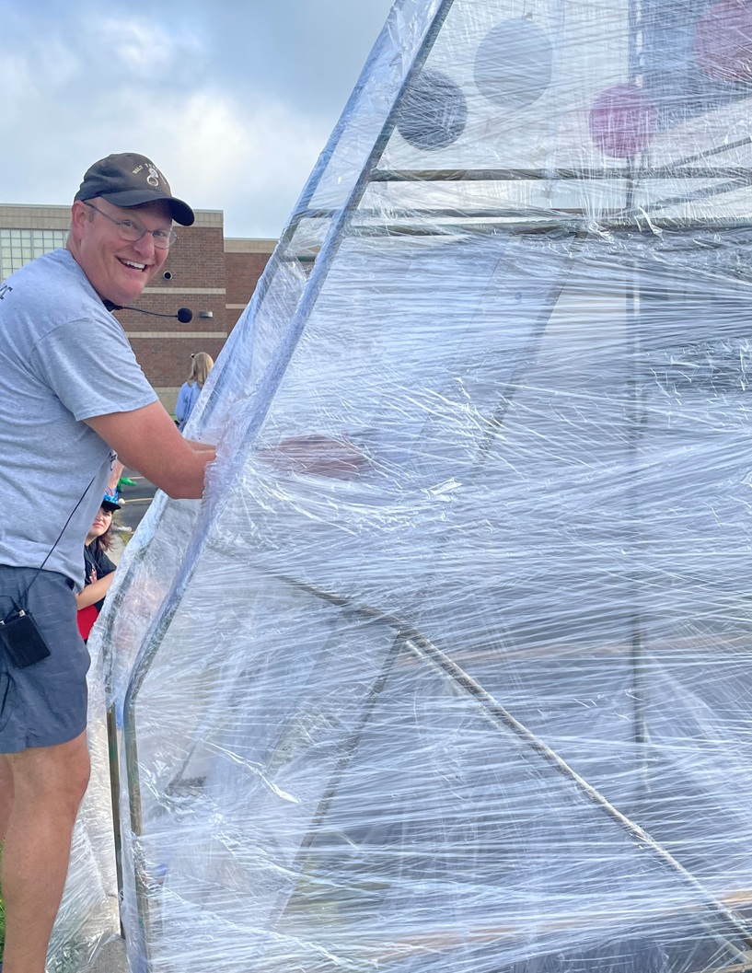
Band Director’s Report

Slide 10
Key Dates Going Forward
Event | Event Date | Comments
Silver Bells | November 17th | Arrive at 4pm HHS
Santa Band | November 29th | Delhi Tree Lighting
Concert/Cookies | November 30th | 7P HHS Auditorium
Band Boosters Meeting | January 9th | 7P Band Room
*See Mr Emerson’s Calendar for details on HHS Boosters Web Site
https://www.holtbandboosters.com/
Notes:
We need cookie cops for the concert- Kristy happy to cover any time except Wind Ensemble

Slide 11
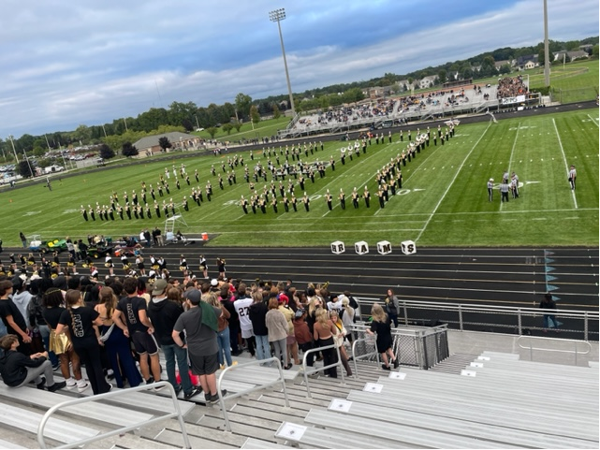
Thanks, for your support!!

