Slide 1



Holt Band Boosters
General Meeting
April 9, 2024

Slide 2
Agenda
Welcome and Introductions
Review Agenda
Updates from the Executive Board and Band Director
Key Dates
Comments/Discussion
Next Meeting- Tuesday 5/14/24
Adjournment

Slide 3
Treasurer’s Report
March 2024
Beginning Balance (All Accounts) - March 1, 2024 |  | $ 16236.26
Ending Balance (All Accounts) - MArch 31, 2024 |  | $ 23697.83
Notes:
Jason will also present the letter for the 2023 annual financial records review.

Slide 4
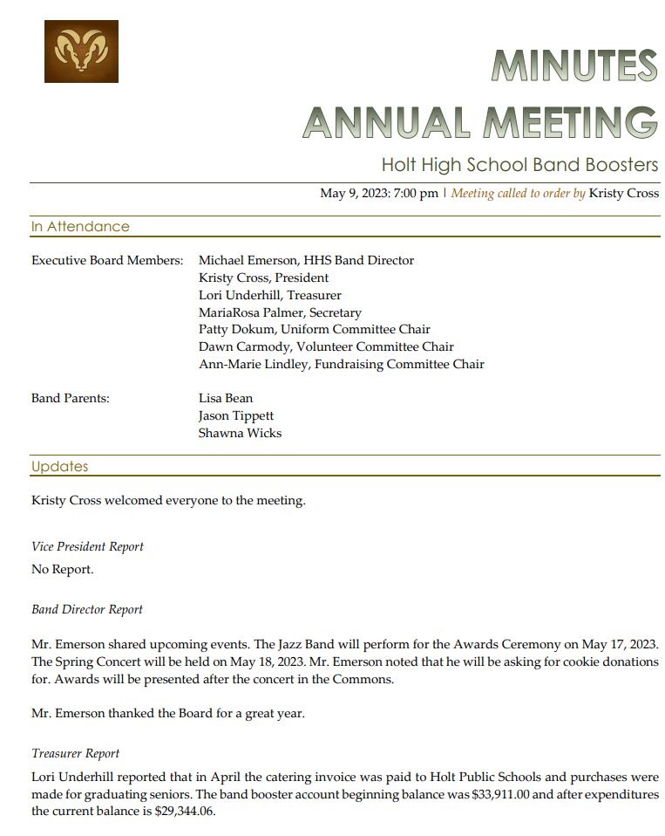
Secretary’s Report

Slide 5
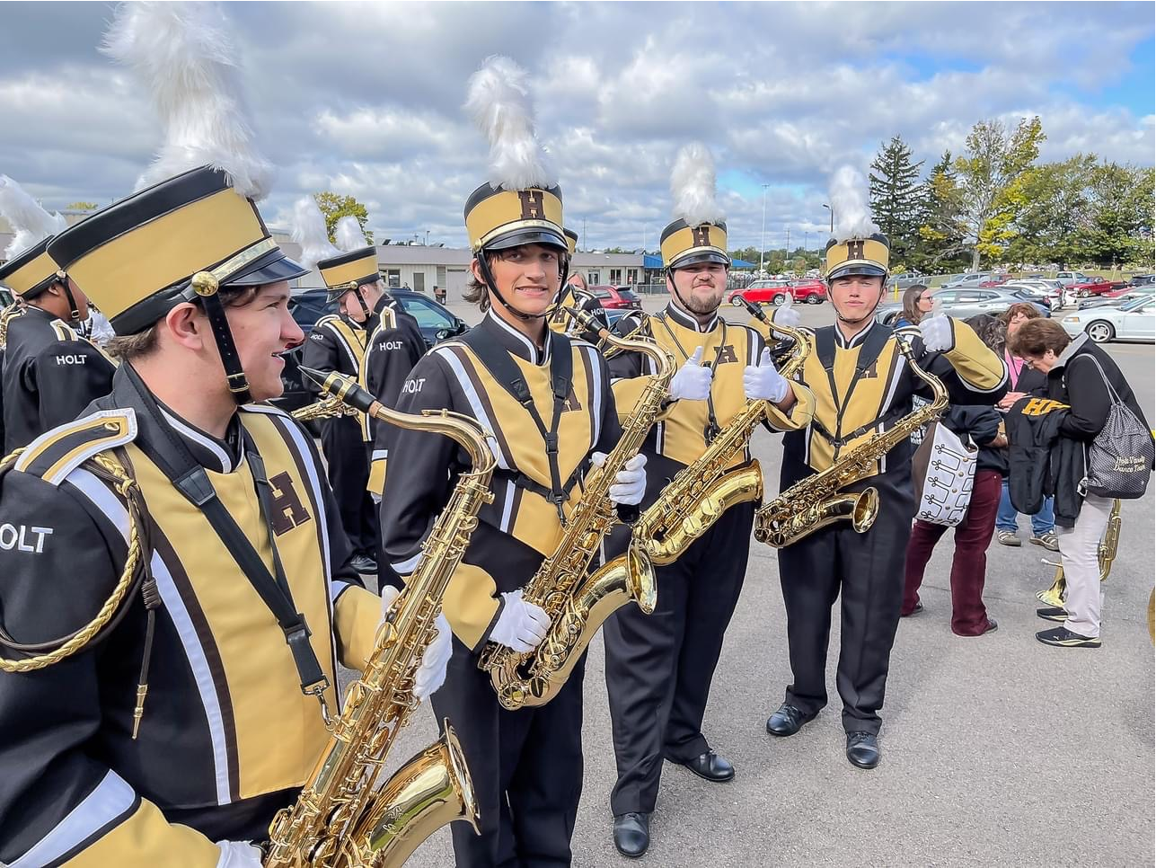
Uniform Assistant Chair Report
Notes:
For the new Wind Ensemble uniforms Patty will review the vest orders and clarify the additional expense there.

Slide 6
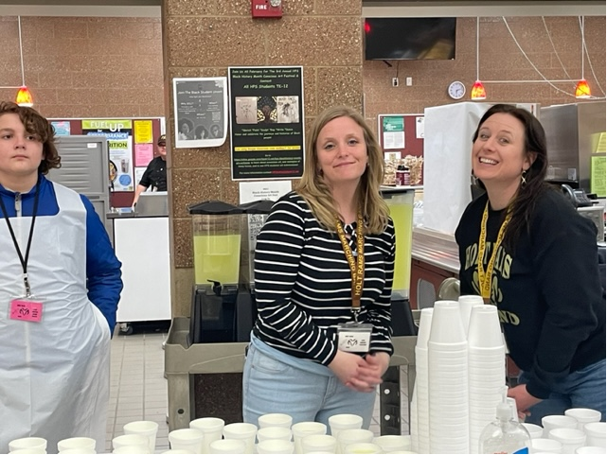
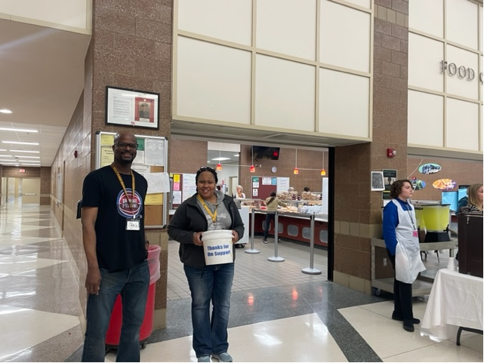
Volunteer Chair’s Report

Slide 7

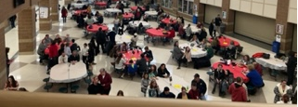
Fundraising Chair Report

Slide 8
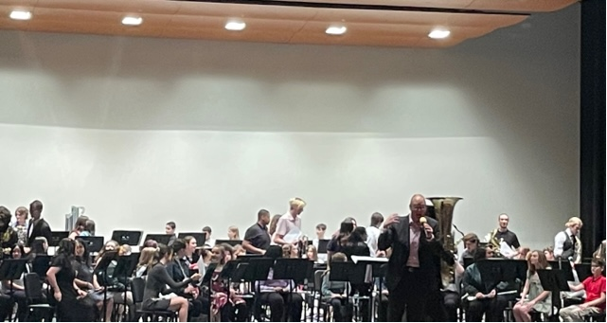
Band Director’s Report

Slide 9
Key Dates Going Forward
EventBB | Event Date | Comments
Tru-District Concert | April 17th | HHS
Band Boosters Meeting | May 14th | HHS Band Room 7pm
Awards and Spring Concert | May 16th | HHS
*See Mr Emerson’s Calendar for details on HHS Boosters Web Site
https://www.holtbandboosters.com/

Slide 10
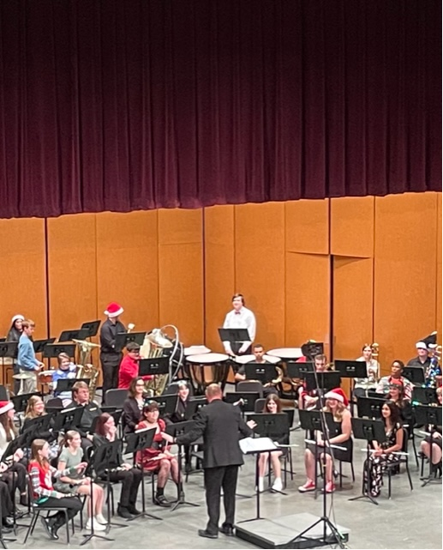
Thanks, for your support!!

