Slide 1
Holt High School Band Boosters
General Meeting
February 7, 2023

Slide 2

Agenda
Welcome
Board of Director Updates
Boosters Financial Updates-Treasurers Report
Key Dates Going Forward
  Volunteer Opportunities
Fundraising Activities
  Band Festival
  Band-Aid
Band Director’s Report
Open Discussion
Next Meeting-March 14, 2023, 7 p.m.
Adjournment

Slide 3


Board of Director Reports
Matt Lincoln Vice President
MariaRosa Palmer Secretary
Lori Underhill Treasurer
Jenn Elliott Asst Treasurer
Patty Dokum Uniform Committee
Dawn Carmody Volunteer Committee
Ann-Marie Lindley Fundraising Committee

Slide 4
Treasurer’s Reports
January,2023
Beginning Balance (All Accounts) – December 31,2022 $ 29584.81
Ending Balance (All Accounts) – January 31,2023 $ 28,559.67

Slide 5
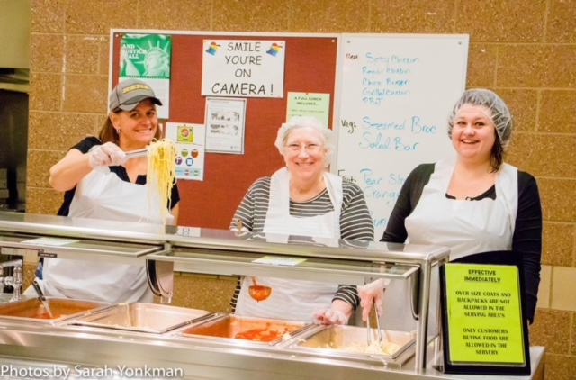
Volunteer Opportunities/Upcoming EventsatesGoing Forward
Event | Event Date | Comments
Pre-Festival Concert | February 16 2023 | Auditorium 7pm
Band Aid Planning Meeting | February 27, 2023 | Location TBD 6pm
Band Festival | March 1 and 2, 2023 | TBD- at Holt High School
Band Aid Concerts and Spaghetti Dinner | March 21, 2023 | Auditorium and Commons

Slide 6
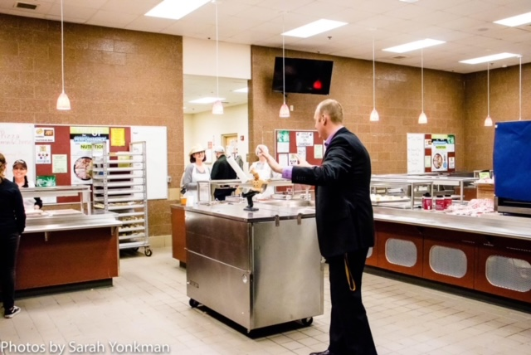
Fundraising Activities
Band Aid- 50/50 Raffle and Spaghetti Dinner
Band Festival – concessions

Slide 7

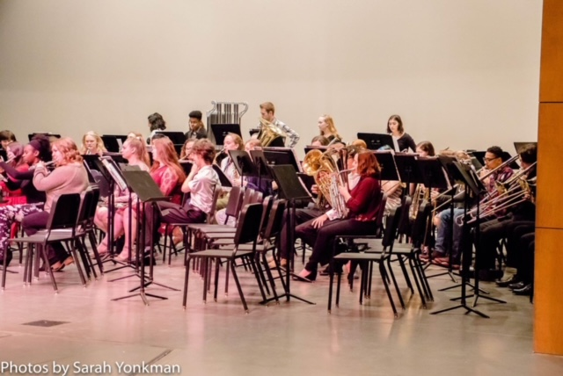
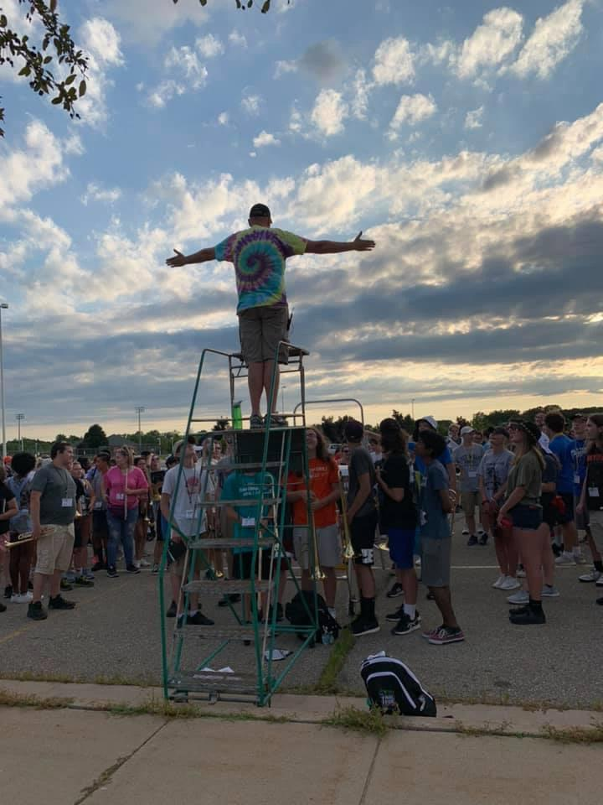
Band Director Report
.

Slide 8

Don’t Forget Our Web Site
www.holtbandboosters.com

Slide 9
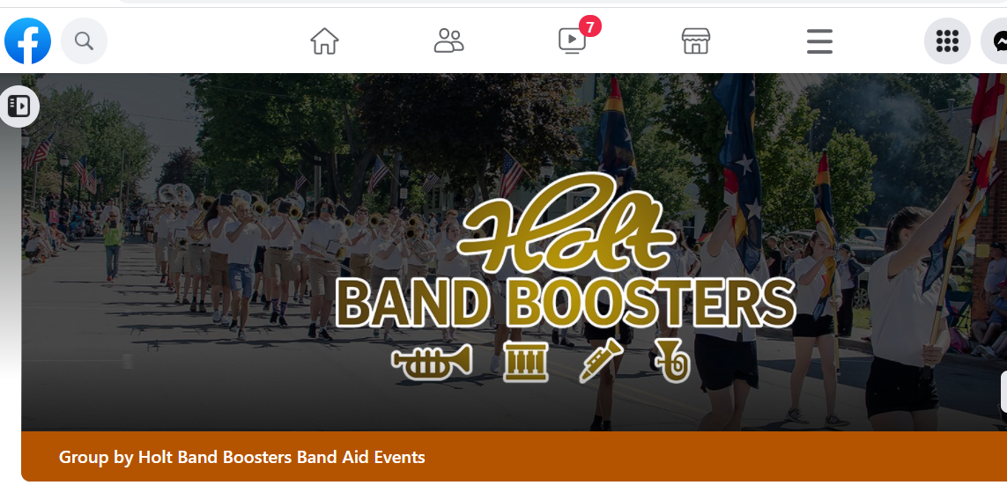
…..And Facebook Page….

Slide 10
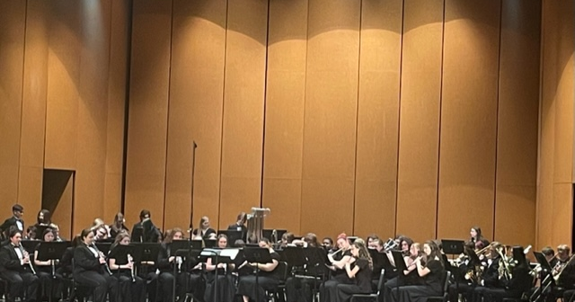

Next Meeting
March 14, 2023
Thank You For Joining!

