Slide 1
Holt Band Boosters
General Meeting
March 12, 2024

Slide 2
Agenda
Welcome and Introductions
Review Agenda
Updates from the Executive Board and Band Director
Key Dates
Comments/Discussion
Next Meeting- Tuesday 4/9/24
Adjournment

Slide 3
Treasurer’s Report
Jan-24
Beginning Balance (All Accounts) - December 1, 2023 |  | $ 21159.49
Ending Balance (All Accounts) - December 31, 2023 |  | $ 16236.28
Notes:
Jason will also present the letter for the 2023 annual financial records review.

Slide 4
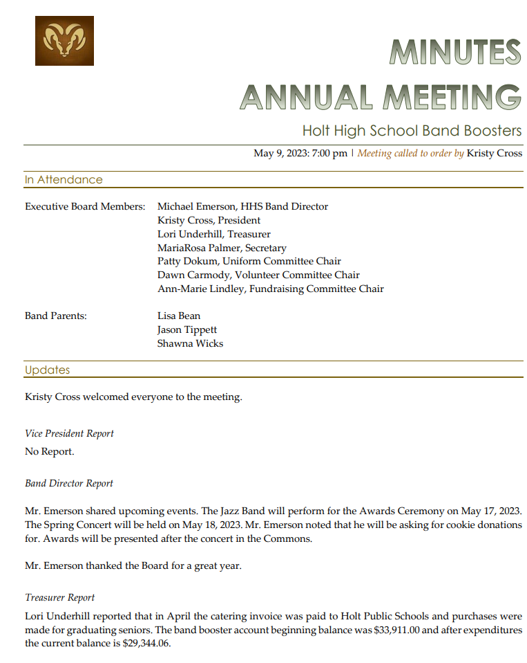
Secretary’s Report

Slide 5
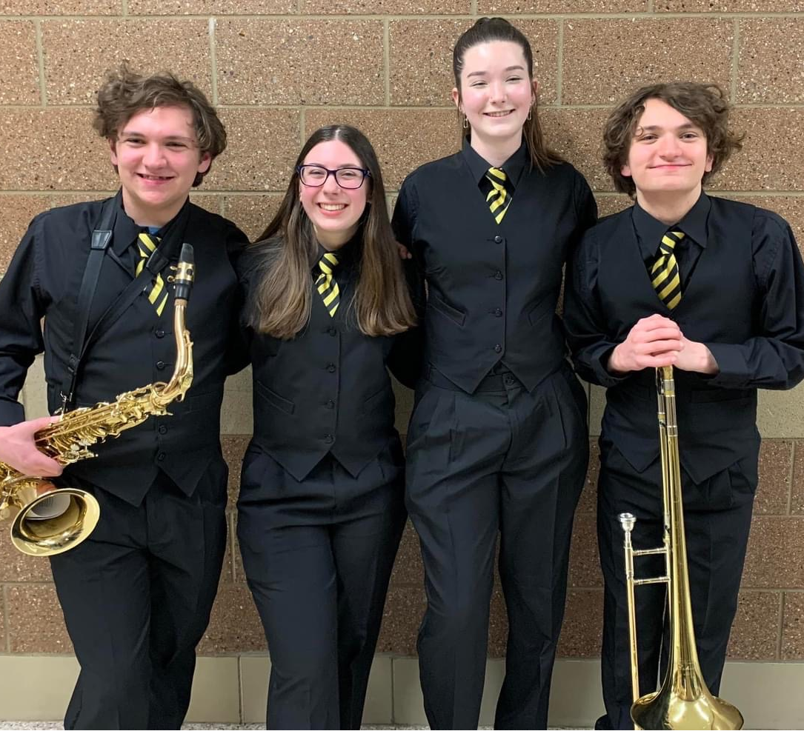
Uniform Assistant Chair Report
Notes:
For the new Wind Ensemble uniforms Patty will review the vest orders and clarify the additional expense there.

Slide 6
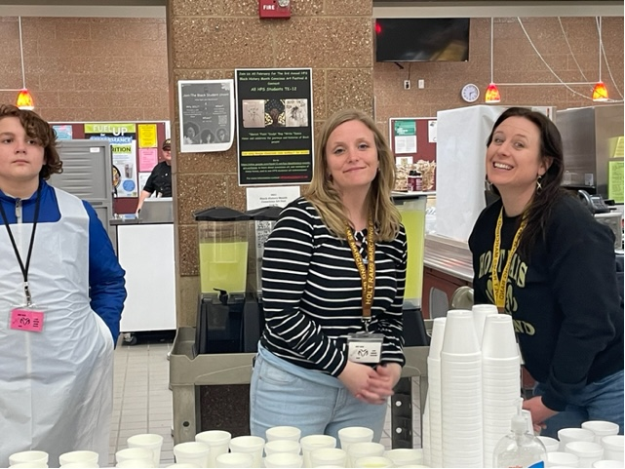
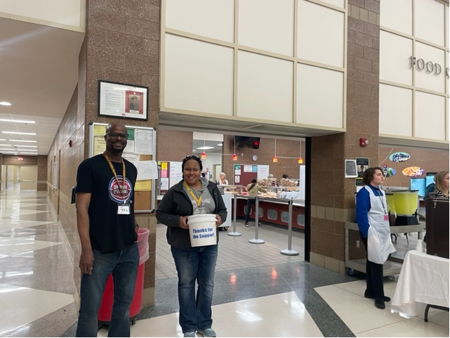
Volunteer Chair’s Report – Update on Band Aid Volunteers

Slide 7
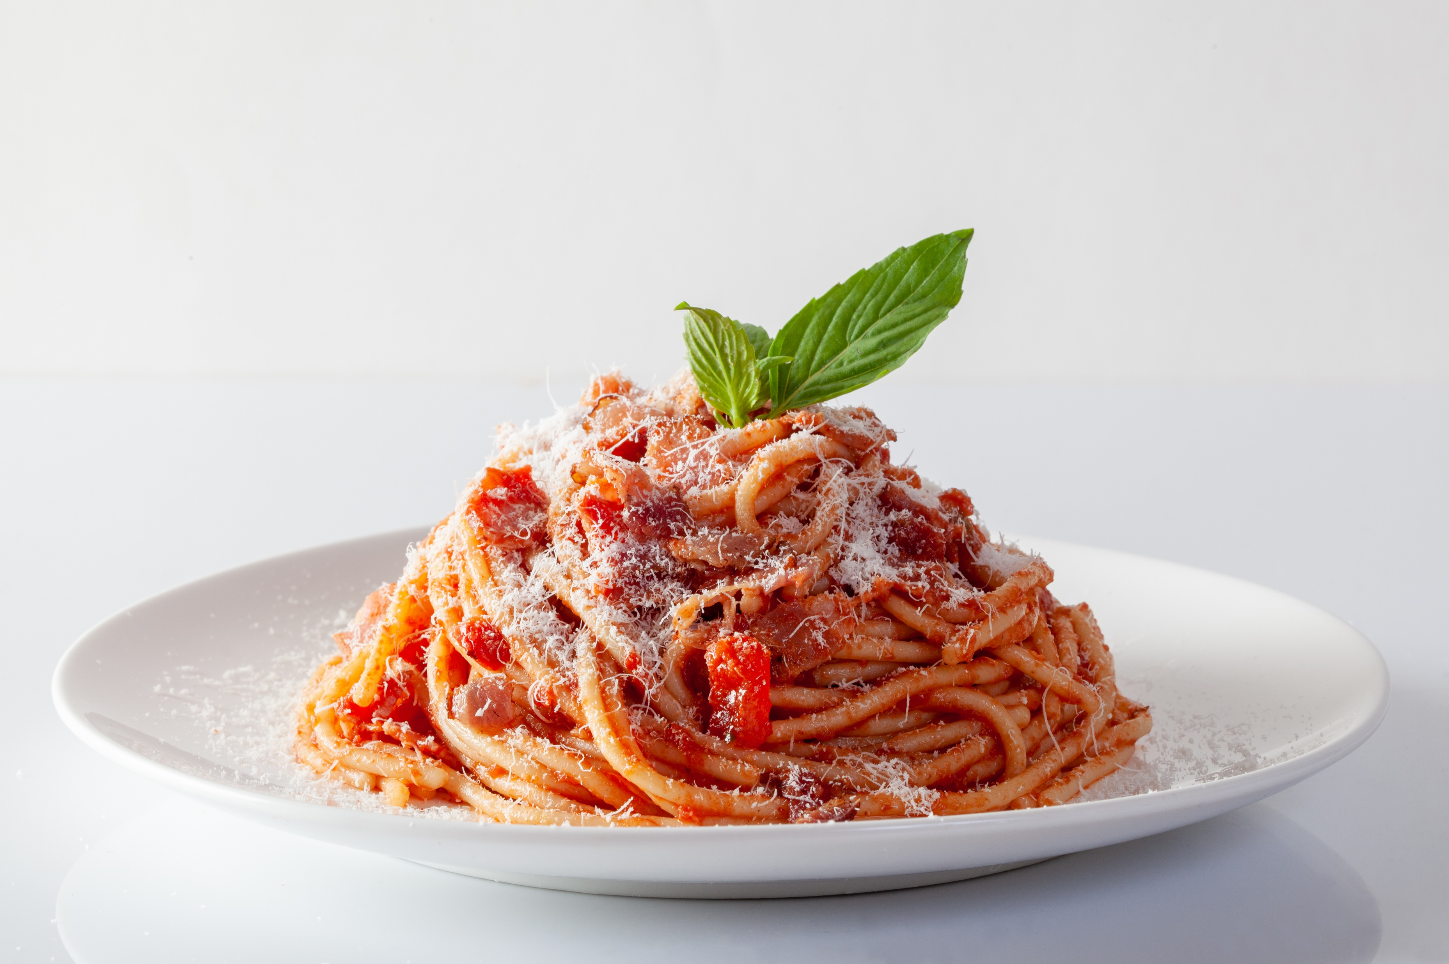
Fundraising Chair Report- Update on Band Aid
Notes:
Wreaths here 4-6pm Thursday 11/16
We did meet to begin planning spaghetti dinner and festival.
We still plan to have the school prep the meal and do a 50/50 raffle.
Plan to advertise earlier and just have on 50/50 raffle
For Festival- not planning concessions- does the Band Director need other support?

Slide 8
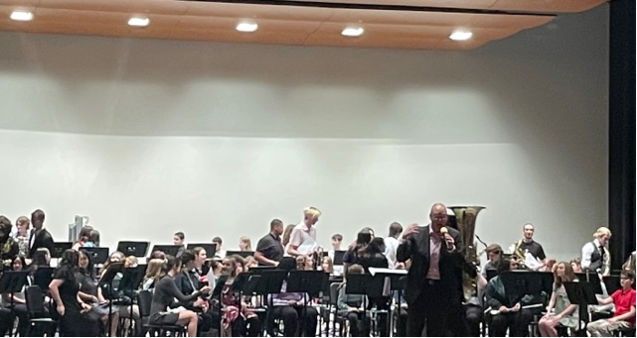
Band Director’s Report

Slide 9
Key Dates Going Forward
EventBB | Event Date | Comments
Band Aid Dinner and Concerts | March 19th | HHS
Tri District Concert | April 17th | Hosted at Holt High School
Band Boosters Meeting | April 9t^{h} | HHS Band Room 7pm
*See Mr Emerson’s Calendar for details on HHS Boosters Web Site
https://www.holtbandboosters.com/

Slide 10
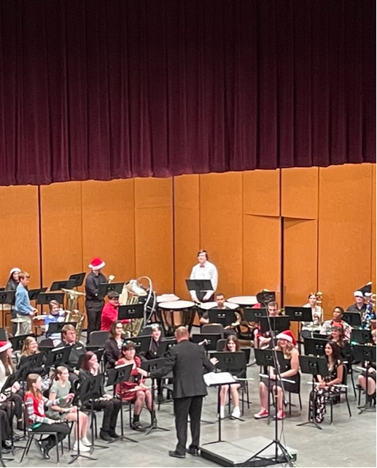
Thanks, for your support!!

