Slide 1


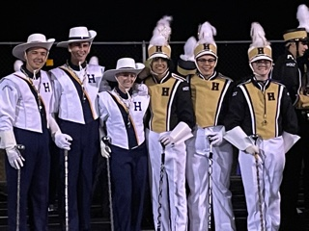

HHS Band Boosters
General Membership Meeting
November 8, 2022

Slide 2
Agenda
Welcome
Board of Director Updates
Boosters Financial Updates
Key Dates Going Forward
  Volunteer Opportunities
Fundraising Activities
  Wreath Sales
  Band Director Platform
  Band Trailer
  Band-Aid
Band Director’s Report
Open Discussion
Next Meeting-January 10, 2023, 7 p.m.
Adjournment

Slide 3

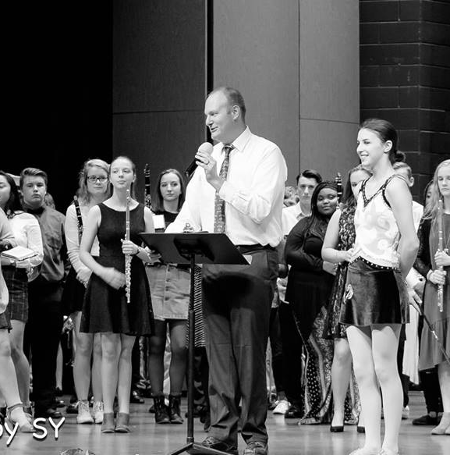
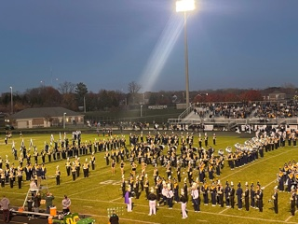
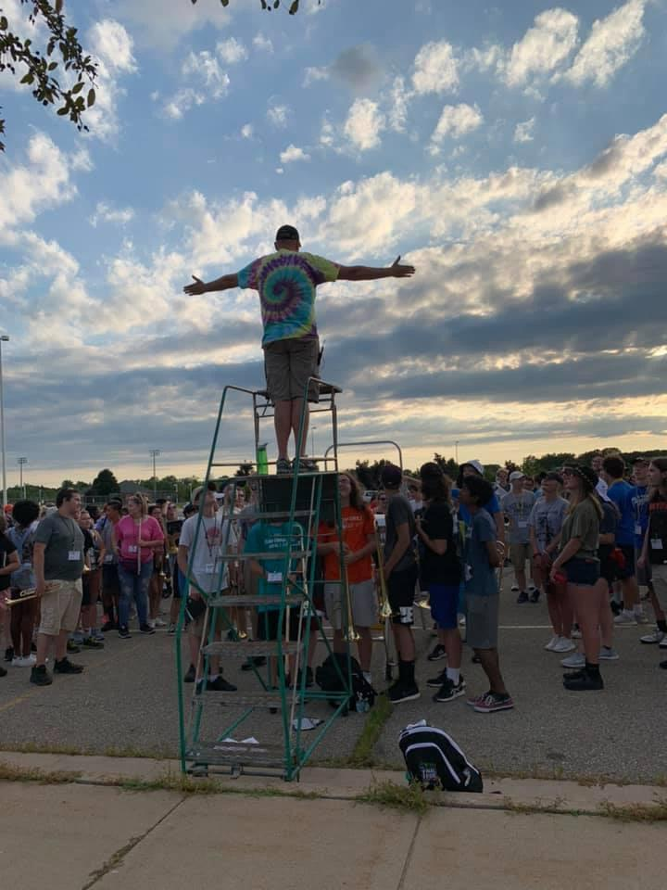
Band Director Report
.

Slide 4
Board of Director Reports
Matt Lincoln Vice President
MariaRosa Palmer Secretary
Lori Underhill Treasurer
Jenn Elliott Asst Treasurer
Patty Dokum Uniform Committee
Dawn Carmody Volunteer Committee
Ann-Marie Lindley Fundraising Committee

Slide 5
Financial Updates
Beginning Balance (All Accounts) - October 1, 2022 : $ 40,116.06
Ending Balance (All Accounts) - October 31, 2022 : $ 40,292.14
Ending Balances as of 10/31/22 $ 40,292.14
MSUFCU Business Spartan Saver $ 15,847.03
MSUFCU Business Checking $ 24,445.11

Slide 6
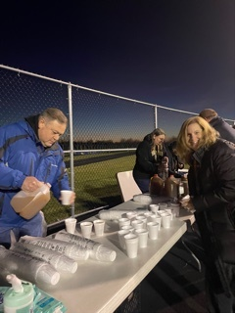
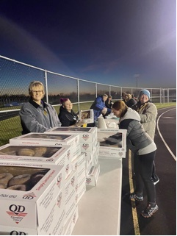
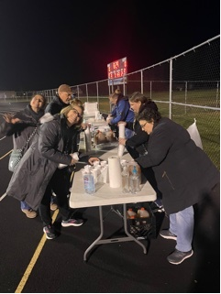
Volunteer Opportunities/Upcoming EventsatesGoing Forward
Event | Event Date | Comments
Santa Band /Delhi Tree Lighting | November 30th | 530pm
Holiday Concert- all Bands | December 1st | Auditorium
Band Boosters Meeting | January 10 | Band Room
Band Festival/Band Aid Planning | November 14 | Time and Location TBD

Slide 7
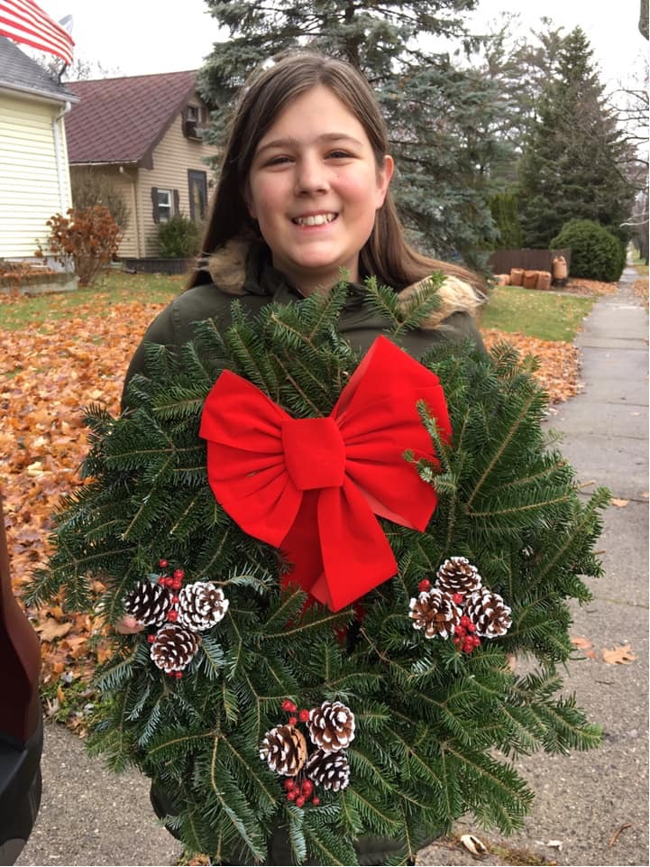
Fundraising Activities
Wreath Sales/Honey
Spaghetti Dinner Planning meeting in November
Band Festival – concessions

Slide 8
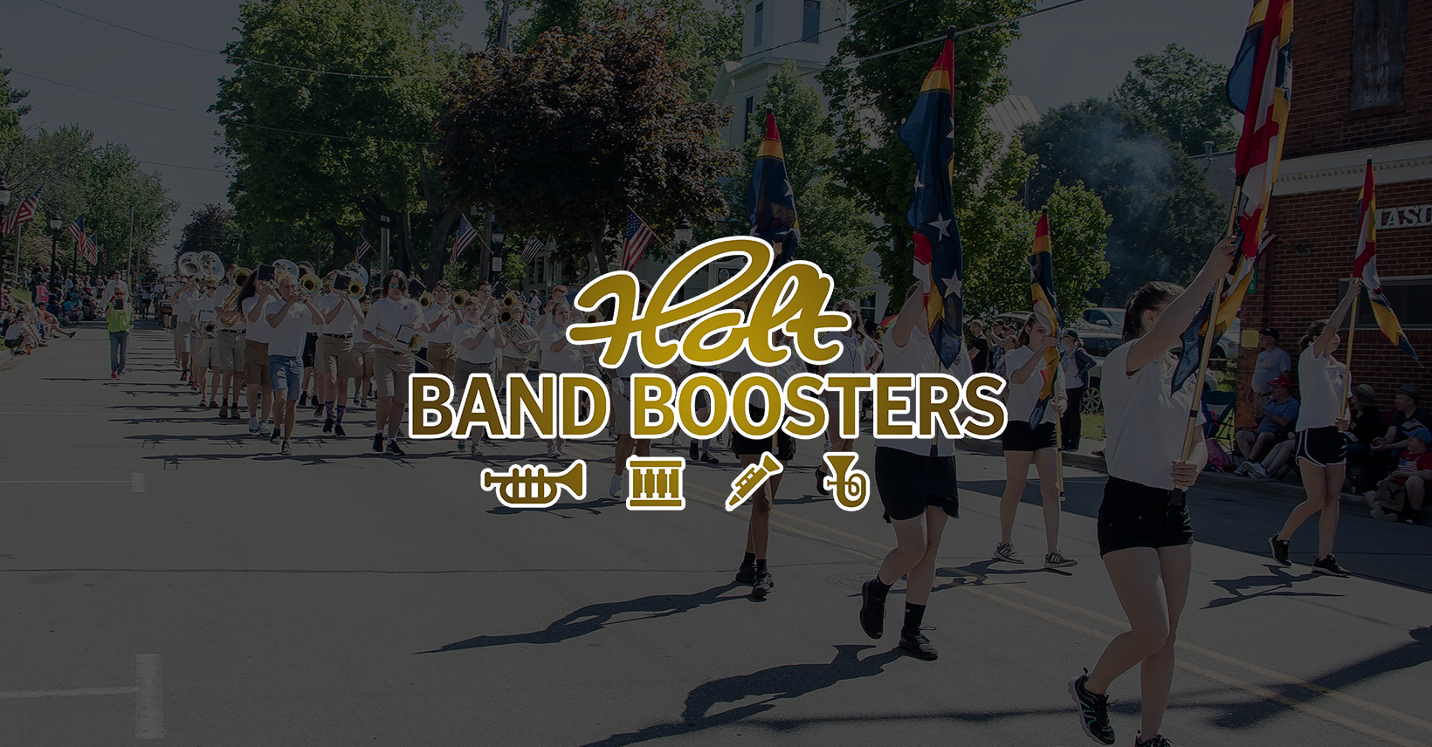
Don’t Forget Our Web Site
www.holtbandboosters.com

Slide 9
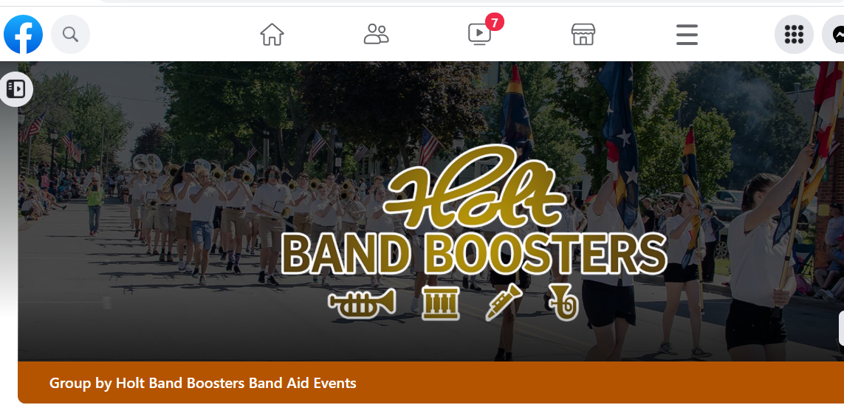
…..And Facebook Page….

Slide 10

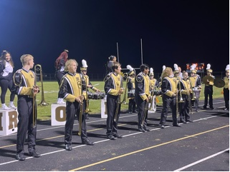

Next Meeting
January 10, 2023
Thank You For Joining!

